Slide 1
CSE 486/586 Distributed Systems Logical Time
Steve Ko
Computer Sciences and Engineering
University at Buffalo

Slide 2
Last Time
Clock skews do happen
External and internal synchronization
Cristian’s algorithm: external synchronization
Berkeley algorithm: internal synchronization
Both designed for LAN
NTP (Network Time Protocol)
Hierarchy of time servers
Estimates the actual offset between two clocks
Designed for the Internet
Logical time
For ordering events, relative time should suffice.
Will continue today

Slide 3
Basics: State Machine
State: a collection of values of variables
Event: an occurrence of an action that changes the state, (i.e., instruction, send, and receive)
As a program,
We can think of all possible execution paths.
At runtime,
There’s only one path that the program takes.
Equally applicable to
A single process
A distributed set of processes
S0
S1
S2
S3
S4
SF

Slide 4

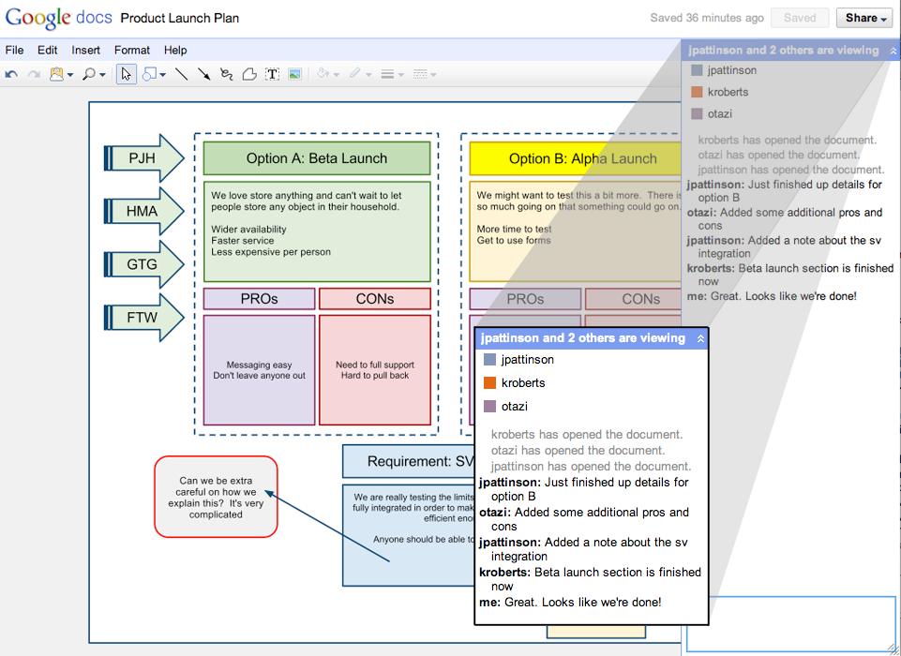
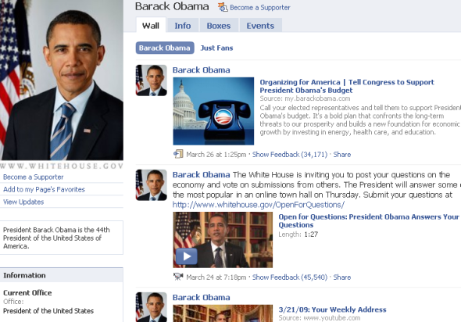
Ordering Basics
Why did we want to synchronize physical clocks?
What we need: Ordering of events.
Arises in many different contexts…

Slide 5
Abstract View
Above is what we will deal with most of the time.
Ordering question: what do we ultimately want?
Taking two events and determine which one happened before the other one.

Slide 6
What Ordering?
Ideal?
Perfect physical clock synchronization
Reliably?
Events in the same process
Send/receive events

Slide 7
Lamport Timestamps

Slide 8
Logical Clocks
Lamport algorithm assigns logical timestamps:
All processes use a counter (clock) with initial value of zero
A process increments its counter when a send or an instruction happens at it. The counter is assigned to the event as its timestamp.
A send (message) event carries its timestamp
For a receive (message) event the counter is updated by max(local clock, message timestamp) + 1
Define a logical relation happened-before (→) among events:
On the same process: a → b, if time(a) < time(b)
If p1 sends m to p2: send(m) → receive(m)
(Transitivity) If a → b and b → c then a → c
Shows causality of events

Slide 9
CSE 486/586 Administrivia
PA2 is out.
Due on 3/1
Start with the content provider.
Please understand the flow of PA1.
Please be careful about your coding style.
Lecture slides
I will try posting them a day before.
I will also post a PDF version.
There is a course website.
Schedule, syllabus, readings, etc.

Slide 10
Find the Mistake: Lamport Logical Time
Physical Time
p 1
0
1
2
4
3
1
p 2
3
4
0
2
2
3
6
p 3
4
0
3
5
6
8
4
7
p 4
0
5
6
7
n
Clock Value
timestamp
Message

Slide 11
Corrected Example: Lamport Logical Time
Physical Time
p 1
0
1
2
8
7
1
p 2
3
8
0
2
2
3
6
p 3
4
0
3
5
9
10
4
7
p 4
0
5
6
7
n
Clock Value
3 and 7 are logically concurrent events
timestamp
Message

Slide 12
Vector Timestamps
With Lamport clock
e “happened-before” f ⇒ timestamp(e) < timestamp (f), but
timestamp(e) < timestamp (f) ⇒ e “happened-before” f
Idea?
X

Slide 13
Vector Logical Clocks
Vector Logical time addresses the issue:
All processes use a vector of counters (logical clocks), i^{th} element is the clock value for process i, initially all zero.
Each process i increments the i^{th} element of its vector upon an instruction or send event. Vector value is timestamp of the event.
A send(message) event carries its vector timestamp (counter vector)
For a receive(message) event, V_{receiver}[j] =
Max(V_{receiver}[j] , V_{message}[j]), if j is not self,
V_{receiver}[j] + 1, otherwise

Slide 14
Find a Mistake: Vector Logical Time
Physical Time
p 1
1,0,0,0
2,0,0,0
4,0,2,2
0,0,0,0
3,0,2,2
(1,0,0,0)
p 2
1,2,0,0
(4,0,2,2)
0,0,0,0
1,1,0,0
(2,0,0,0)
(1,2,0,0)
(2,0,2,2)
p 3
0,0,0,0
2,0,2,0
2,0,1,0
2,2,3,0
4,2,4,2
4,2,5,3
(2,0,2,0)
(2,0,2,3)
p 4
0,0,0,0
2,0,2,2
2,0,2,1
2,0,2,3
n,m,p,q
Vector logical clock
(vector timestamp)
Message

Slide 15
Comparing Vector Timestamps
VT₁ = VT₂,
iff VT₁[i] = VT₂[i], for all i = 1, … , n
VT₁ <= VT₂,
iff VT₁[i] <= VT₂[i], for all i = 1, … , n
VT₁ < VT₂,
iff VT₁ <= VT₂ & ∃ j (1 <= j <= n & VT₁[j] < VT₂ [j])
VT₁ is concurrent with VT₂
iff (not VT₁ <= VT₂ AND not VT₂ <= VT₁)

Slide 16
The Use of Logical Clocks
Is a design decision
NTP error bound
Local: a few ms
Wide-area: 10’s of ms
If your system doesn’t care about this inaccuracy, then NTP should be fine.
Logical clocks impose an arbitrary order over concurrent events anyway
Breaking ties: process IDs, etc.

Slide 17
Summary
Relative order of events enough for practical purposes
Lamport’s logical clocks
Vector clocks
Next: How to take a global snapshot

Slide 18
Acknowledgements
These slides contain material developed and copyrighted by Indranil Gupta at UIUC.

